Slide 1
IRONHACK Project Visualizing Real World Data
File created on: 9/21/2022 6:31:08 PM

Slide 2
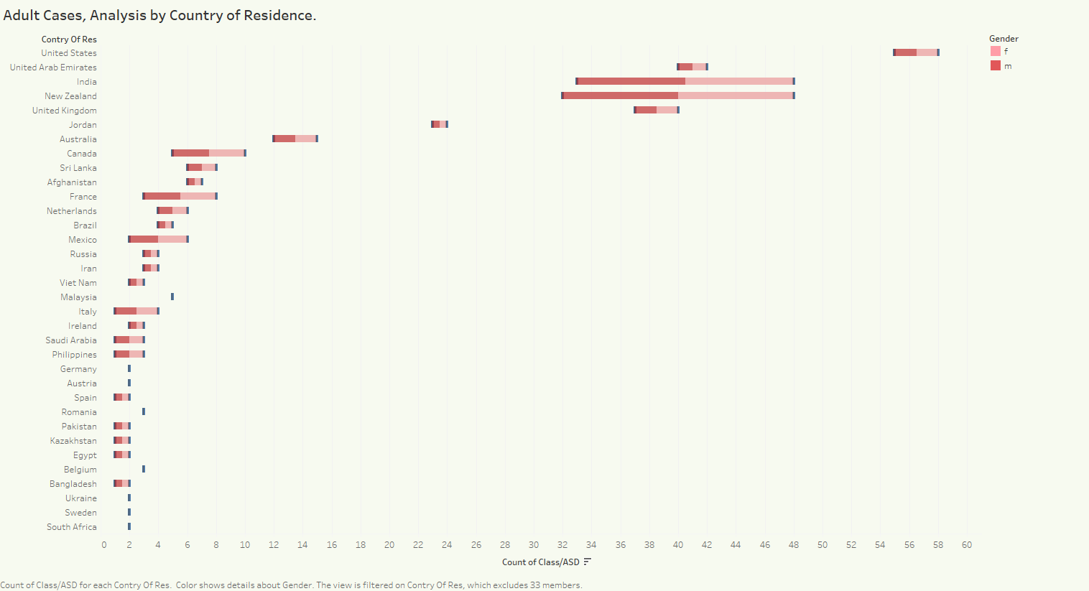

Slide 3
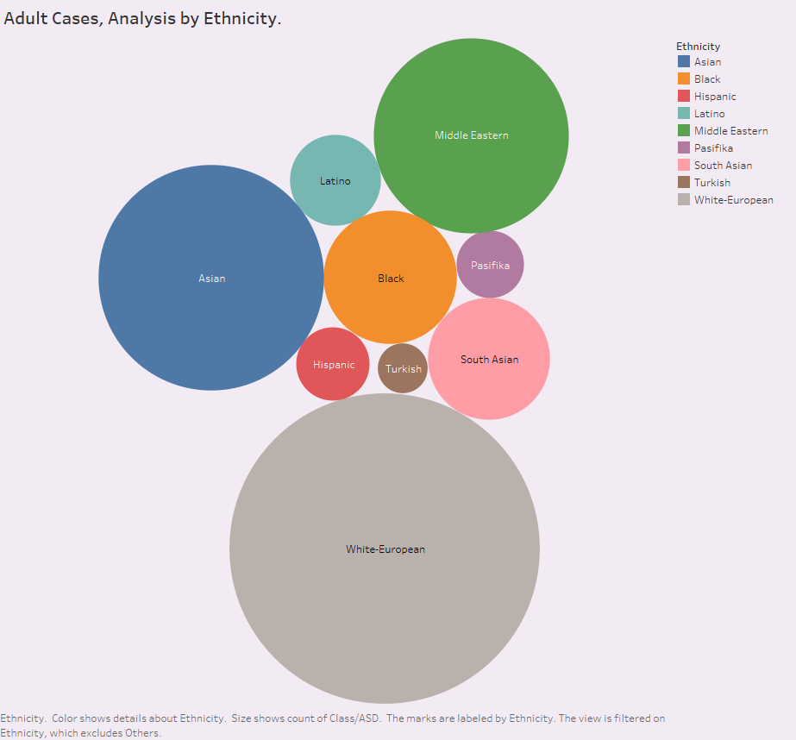

Slide 4
